Slide 1
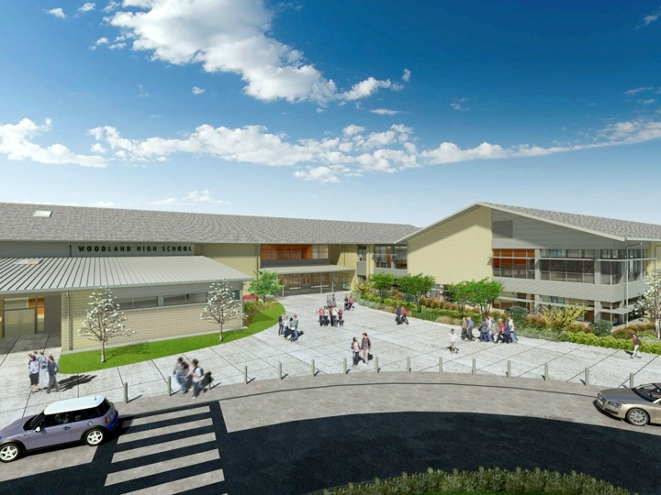
Woodland Public Schools
Facilities Report June
2024

Slide 2
Facilities Report
Middle School Roof Replacement – We will be replacing the roofing and gutters on the WMS Yellow Gym classroom wing this summer. The replacement for this roof was necessary due to age and condition. We had a few new leaks this last winter and determined we can’t wait any longer for it’s replacement.
North Fork Portable – The construction of the portable will be complete by August 1st, with the portable being delivered mid-August. After delivery, the portable will still need to have all utilities and furnishings installed. With all the setup required after delivery, it’s highly likely the portable won’t be ready for staff and students until after the start of the 2024-2025 school year.
3rd Street Drainage – We are working with the City of Woodland to fix the drainage issues on 3rd Street, as it comes into the Middle School area. During heavy rains, the area floods and becomes a hazard. The City will be coming in this summer and installing a new drain system.
Routine Summer Projects – We have many summer projects coming up including, classroom and office moves, painting, floor waxing, grounds maintenance and deep routine cleaning.

